Slide 1
Chapter 3: The Neoliberal Stew: A Dozen Essential Ingredients
“Hear me, people: We have now to deal with another race – small and feeble when our fathers first met them, but now great and overbearing. Strangely enough they have a mind to till the soil and the love of possessions is a disease with them. These people have made many rules that the rich may break but the poor may not. They take their tithes from the poor and weak to support the rich and those who rule.” …. Chief Sitting Bull

Slide 2
Chief Sitting Bull
Notes:
What does his quote in your book mean to you? Wikipedia

Slide 3
The Philosophy of Neoliberalism, Milton Friedman
Notes:
Philosophy of neoliberalism – on the Milton Friedman. Wikipedia

Slide 4
Federal Reserve Chairmen
Notes:
Different approaches to the Federal Reserve – Marriner Eccles on the right, Alan Greenspan on the left. What were these different approaches? Wikipedia

Slide 5
The Neoliberal Stew 12 Ingredients
#1 Free Trade
#2 Privatization
#3 Deregulation
#4 Limited Government
#5 Supply Side Economics
#6 Lower Taxes
#7 Markets Know Best
#8 Reduce the Deficit
#9 Support Corporations and Financial Sector
#10 “Free” Labor
#11 Rugged Individualism
#12 Spreading Neoliberalism

Slide 6
Ingredient #1 Free Trade
Notes:
Alexander Hamilton statue outside the Treasury Bldg, Washington D. C. He also graces the $10 bill. What was his stance on trade? What do you think his stance would be on trade today? Wikipedia

Slide 7
Smoot – Hawley Tariff Act, 1929
Notes:
Willis C. Hawley (left) and Reed Smoot in April 1929, shortly before the Smoot-Hawley Tariff Act passed the House of Representatives. Wikipedia

Slide 8
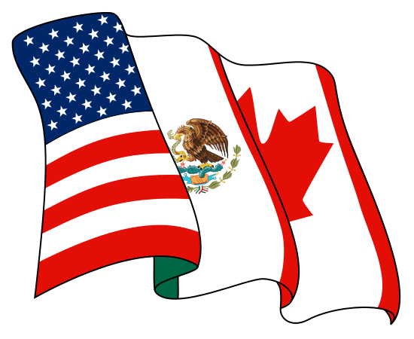
NAFTA Coat of Arms
Notes:
Coat of arms of North American Free Trade Agreement Tratado de Libre Comercio de América del Norte (Spanish) Accord de Libre-échange Nord-Américain (French) Wikipedia

Slide 9
North American Free Trade Association NAFTA
Notes:
One of NAFTA’s signing ceremonies, October 1992 in Mexico. Who are the people at the ceremony? Wikipedia

Slide 10
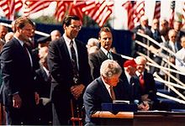
NAFTA
Notes:
Free Trade and NAFTA were supported by both Democrats and Republicans, here President Bill Clinton signs the agreement. Wikipedia

Slide 11
Ingredient #2 Privatization
Notes:
Privatization of land held communally by Native Americans. A 1911 ad offering “Allotted Indian Land” for sale as a result of the Dawes Act in 1887. Wikipedia

Slide 12
Transportation Security Administration TSA
Notes:
Seal when under the Department of Transportation. Attempts have been made to privatize these public agency. Wikipedia

Slide 13
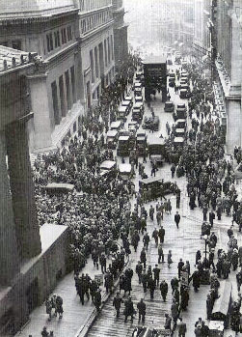
Ingredient #3 Deregulation
Notes:
Crowd gathering on Wall Street during the Stock Market crash of 1929. The crash was due, in part, to a lack of regulation of the market. Wikipedia

Slide 14
Deregulation: Glass-Steagall Act, 1933
Notes:
Sen. Carter Glass (D–Va.) and Rep. Henry B. Steagall (D–Ala.-3), the co-sponsors of the Glass–Steagall Act. Wikipedia

Slide 15
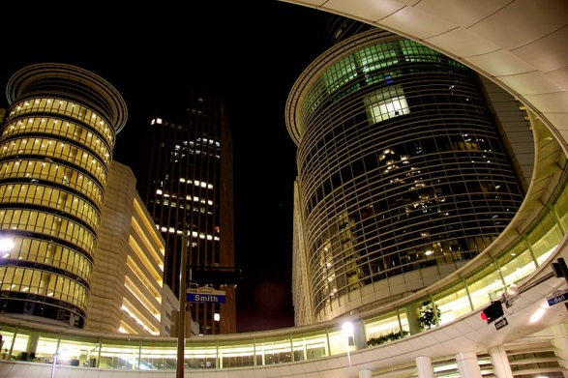
Enron Headquarters, Houston, TX
Notes:
Wikipedia

Slide 16
Water Privatization
Notes:
Many municipal water supplies are targeted for privatization. Wikipedia

Slide 17
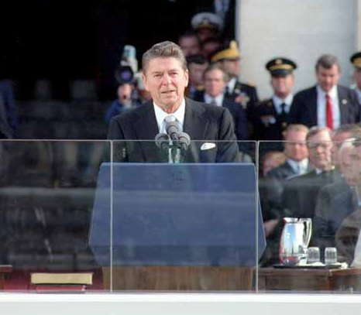
Ingredient #4 Small Government
Notes:
Ronald Reagan supported a small government. Wikipedia

Slide 18
Ingredient #5 Supply Side Economics
Notes:
Supply-side economics proposes that tax decreases lead to economic growth. Historical data, however, shows no correlation between lower top marginal tax rates and GDP growth rate. Wikipedia

Slide 19
Ingredient #6 Lower Taxes
Notes:
Wikipedia

Slide 20
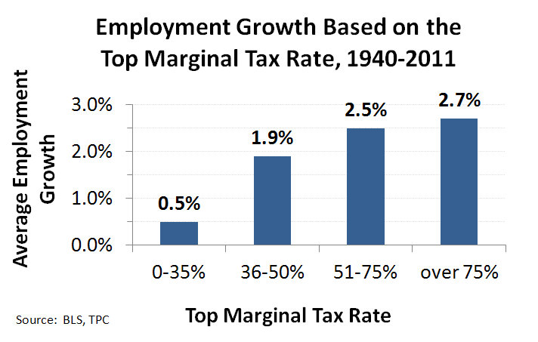
Notes:
Wikipedia

Slide 21
Notes:
Wikipedia

Slide 22
Warren Buffett
Notes:
Warren Buffett is an American business magnate, investor and philanthropist. He was the most successful investor of the 20th century. Buffett is the chairman, CEO and largest shareholder of Berkshire Hathaway, and consistently ranked among the world's wealthiest people. Wikipedia

Slide 23
Ingredient #7 Reduce the Deficit
Notes:
Wikipedia

Slide 24
Notes:
Wikipedia

Slide 25
Notes:
Congressional Outlays. Wikipedia

Slide 26
Ingredient #8 Markets Know Best
Homo Economicus
Economic Man

Slide 27
Ingredient #9 Support of Corporations
Notes:
Wikipedia

Slide 28
Support of Corporations Santa Clara County v. Southern Pacific Railroad
Notes:
Bancroft Davis, the Court Reporter in the Santa Clara County v. Southern Pacific Railroad and former president of Newburgh and New York Railway. Wikipedia

Slide 29
John D. Rockefeller, One of the first industrial tycoons
Notes:
Rockefeller as an industrial emperor, 1901 cartoon from Puck magazine. John Davison Rockefeller, Sr. (July 8, 1839 – May 23, 1937) was an American business magnate and philanthropist. He was a co-founder of the Standard Oil Company, which dominated the oil industry and was the first great U.S. business trust. Wikipedia

Slide 30
Ingredient #10 Labor, Knights of Labor
Notes:
Knights of Labor was the largest and one of the most important American labor organizations of the 1880s. Its most important leader was Terence V. Powderly. The Knights promoted the social and cultural uplift of the workingman, rejected Socialism and radicalism, demanded the eight-hour day. and promoted the producers ethic of republicanism. Wikipedia

Slide 31
American Federation of Labor
Notes:
Left The American Federation of Labor (AFL) was the first federation of labor unions in the United States. It was founded in Columbus, Ohio, in May 1886 by an alliance of craft unions disaffected from the Knights of Labor, a national labor association. Samuel Gompers of the Cigar Makers' International Union was elected president of the Federation at its founding convention and was reelected every year except one until his death in 1924. Wikipedia
Right Samuel Gompers in the office of the American Federation of Labor, 1887.

Slide 32
Union Man’s Burden
Notes:
1922 cartoon from the American Federationist. The caption reads: THE UNION MAN'S BURDEN, Every Organized Worker Carries an Unorganized Worker "Strapped to His Back". Wikipedia

Slide 33
Labor Union
Notes:
AFSCME members by the US Capitol, 2013. The American Federation of State, County and Municipal Employees (AFSCME) is a major trade union in the United States. It represents approximately 1.5 million workers, most of whom work in the public sector. The union has become known in recent years for its involvement in political campaigns. Wikipedia

Slide 34
Rise and Fall of Union Membership in the United States 1930-2010
Notes:
Wikipedia

Slide 35
Wages
Notes:
Wikipedia

Slide 36
Ingredient #11 Rugged Individualism
Notes:
Atlas Shrugged is a 1957 novel by Ayn Rand. it expresses the advocacy of reason, individualism, capitalism, and the failures of governmental coercion. Wikipedia

Slide 37
Ingredient #12 Spreading Neoliberalism
Notes:
Wikipedia

